Slide 1

RELATIVE ANALYSIS OF OUT OF SCHOOL RATE IN LOWER SECONDARY EDUCATION BETWEEN EASTERN AND WESTERN AFRICA (SDG 4.1.4)
HerAnalyticsHub
GROUP 2

Slide 2
Project Outline
Introduction
Dashboard
Insights
Conclusion

Slide 3
Introduction
Sustainable Development Goal 4 (Quality Education) is one of the 17 Sustainable development goals established by the United Nations in September 2015.
It aims at ensuring inclusive and equitable quality education and promotes lifelong learning opportunities for all.
Out-of-school rate (Lower secondary education) which is the SDG goal 4.1.4 is the percentage of children or young people who are not attending lower secondary.
Through this comparative analysis, our goal is to look into the unique educational challenges faced in ten African countries across the Eastern and Western Africa.
Our study will focus on these ten countries which are: Benin, Ethiopia, Ghana, Kenya, Nigeria, Rwanda, Senegal, Togo, Uganda, Zambia.

Slide 4
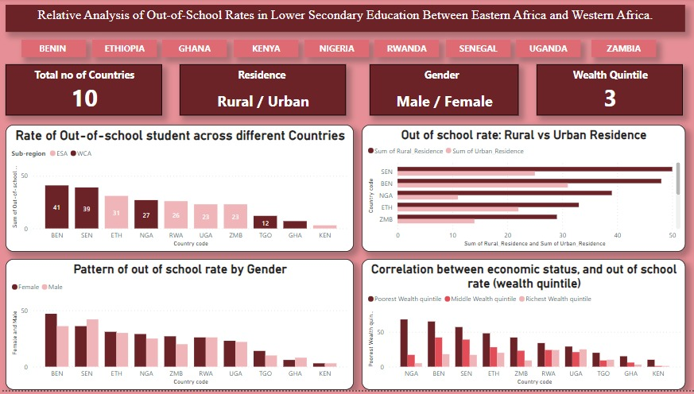
Dashboard

Slide 5
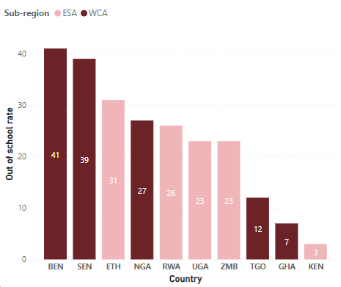
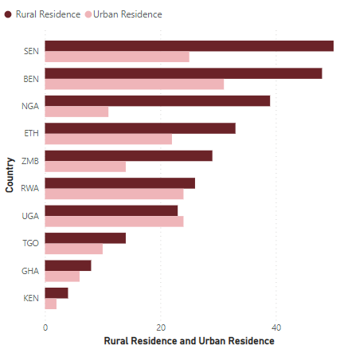
Project Insight
Project Insight
Out-of-school rate across different Countries
Out of school rate: Rural vs Urban Residence
Comment
Comment
The highest percentage of out of school is 41% in Benin while Kenya recorded lowest at 3% .
Rural areas face a higher out-of-school rate than urban areas, posing a significant challenge for children's education in both regions.
Conversely, the urban out-of-school rate in Uganda is higher than the rural out-of-school rate.

Slide 6
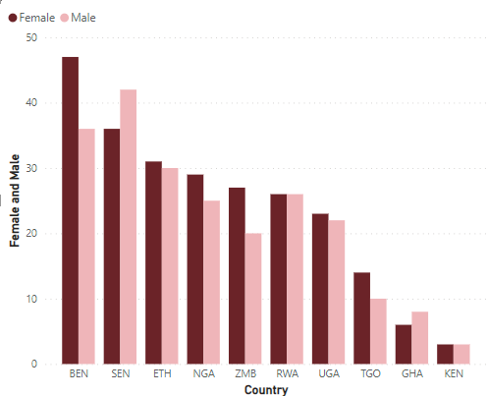
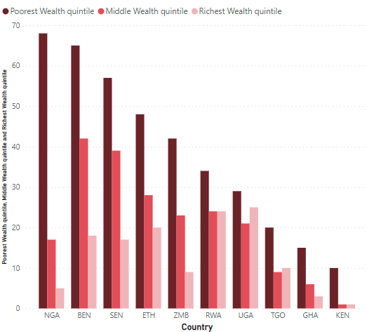
Project Insights
INSIGHTS
Pattern of out of school rate by Gender
Correlation between economic status (wealth quintile)
and out of school rate
Comment
Comment
Benin has the highest out-of-school rate among females, while Senegal tops in males. In contrast, Rwanda and Kenya exhibit equal numbers of males and females facing out-of-school challenges.
Nigeria has the highest out-of-school rates among the poorest, Benin leads in the middle wealth quantile, and Uganda tops the richest. In Kenya and Rwanda, out-of-school rates differ significantly only among the poorest, contrasting with Zambia, Ethiopia, Senegal, and Nigeria.

Slide 7
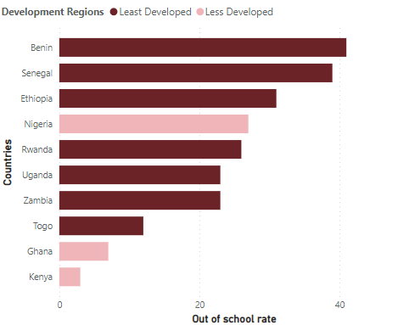
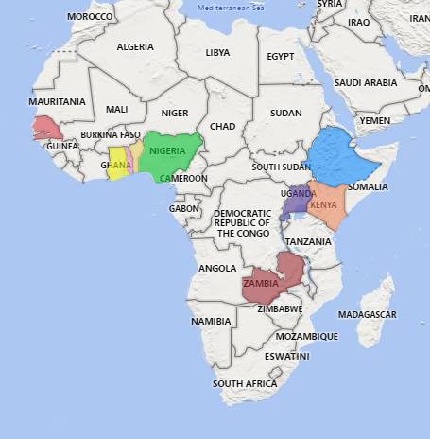
Project Insights
INSIGHTS
Out of school rate by Development Levels
Map of countries Used for the analysis
Correlation between economic status, and out of school rate (wealth quintile)
Comment
Despite Nigeria being less developed, its out-of-school rate is higher than Uganda, Zambia, and Togo.

Slide 8
Conclusion and Recommendations
Benin's 41% out-of-school rate highlights the need for tailored national strategies, Implement insights from successful models like Kenya to reduce rates.
The urban-rural gap in out-of-school rates, especially in Uganda, calls for region-specific approaches ensuring equitable education access.
Most countries face higher female out-of-school rates, except Senegal and Ghana with more males affected. Implement targeted programs for equal gender access, addressing country-specific challenges.
Nigeria has the highest rates among the poorest, Benin leads in the middle wealth, and Uganda tops the richest. Intervention based on wealth, prioritizing the unique challenges of the poorest while ensuring inclusivity.
Despite lower development, Nigeria has higher out-of-school rates than Uganda, Zambia, and Togo, there should be demand for strategic development, particularly in Nigeria.

Slide 9
THANK YOU !!!

